Slide 1
Fold Mountains
By Caitlin and Esme

Slide 2
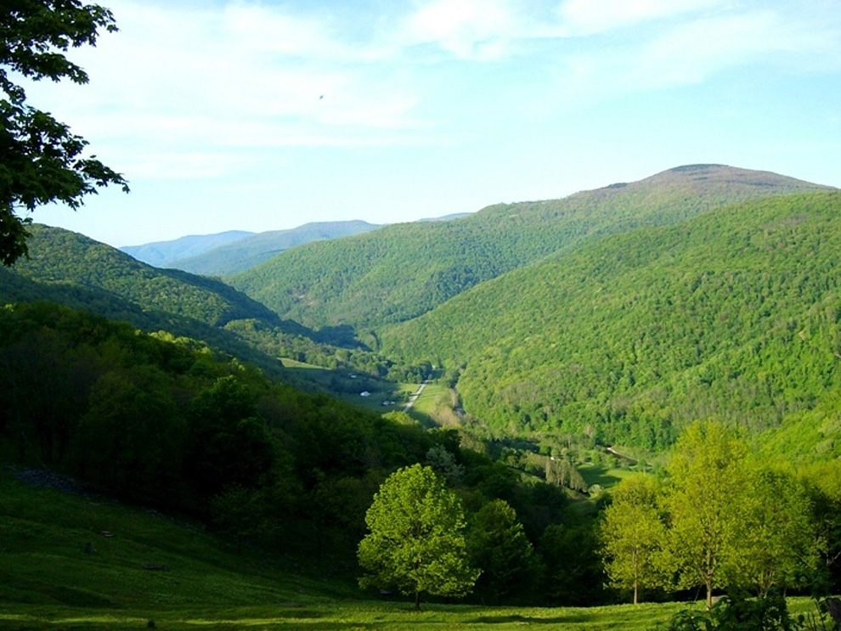
Fold mountains form over millions of years, as layers of the Earth's crust fold on top of each other. Millions of years ago, the North American tectonic plate and the Eurasian tectonic plate folded into each other, forming the Appalachian Mountains as shown in the picture.

Slide 3
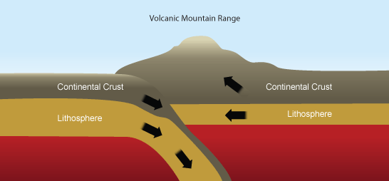
Fold mountain formation
Fold mountains= mountain ranges, created through a process called ‘orogeny’, where two tectonic plates push together over millions of years to make up the earths crust; whereby the extreme pressure forces the edges of the plates upwards into a series of folds.

Slide 4
Fold mountains occur near convergent or compressional plate boundaries.
Rocks are folded upwards = anticlines
Folded downwards = synclines
Severely folded and faulted rocks = nappes

Slide 5
Fold mountains are found in:
Alps
Rockies
Andes
Himalayas

Slide 6
Characteristics of the Alps:
Matterhorn, Zermatt, Switzerland
High mountain ranges, eg Mont Blanc (4,810 m above sea level.)
Glaciated valleys, eg the Rhone Valley.
Pyramidal peaks, eg the Matterhorn.
Ribbon lakes, eg Lake Como.
Fast-flowing rivers.
Contrasting microclimates on north facing (ubac) and south facing (adret) slopes.
Geologically young (30-40 million years old).

Slide 7
Human activity surrounding fold mountains:
Winter sports such as skiing in resorts such as Chamonix.
Climbing and hiking in the summer months.
Summer lakeside holidays, eg Lake Garda.
Agriculture - takes place mainly on south facing slopes and includes cereals, sugar beet, vines and fruits.
Forestry - coniferous forests for fuel and building.
Communications - roads and railways follow valleys.
Hydroelectric power (HEP) - steep slopes and glacial meltwater are ideal for generating HEP. Hydroelectric accounts for 60 per cent of Switzerland's electricity production.

